Slide 1
Review of Feedback Control System

Slide 2
Reactor Control
F, C_{A0}
A→ B
Steps for designing control system
Select Control architecture
Feedback (initial)
Find Transfer function model for the process
Using model equation
Using Process Data
Selecting Controller algorithm
PID controller
Other types
F, C_{A}

Slide 3
General Feedback Control Loop
d(s)
G_{d}(s)
y_{sp}(s)
e(s)
c(s)
u(s)
G_{P}(s)
+
y(s)
K_{S}
-
G_{C}(s)
G_{a}(s)
+
+
y_{S}(s)
G_{S}(s)

Slide 4
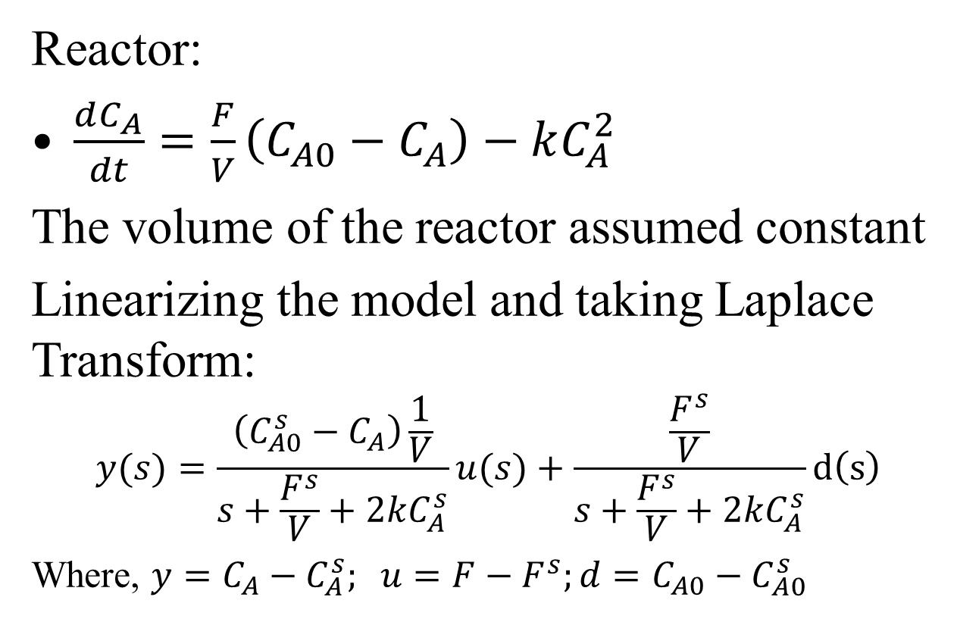
Transfer Function Model (Theory)
s
s

Slide 5
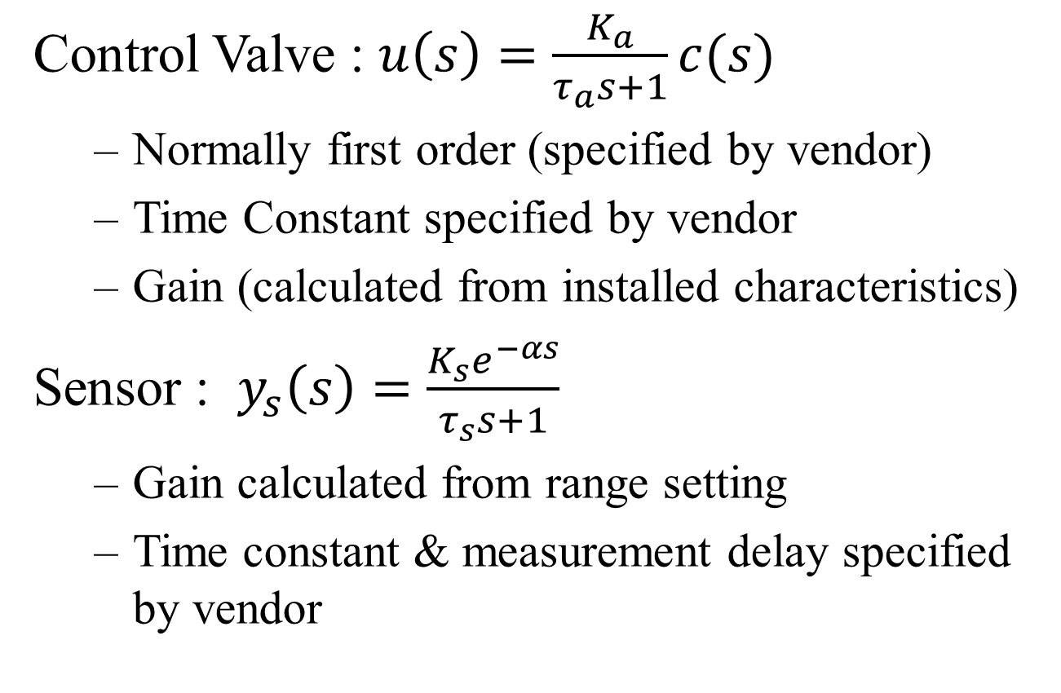
Transfer Function Model (Theory)
Control Valve : $u\left(s\right)=\frac{K_{a}}{τ_{a}s+1}c(s)$
Normally first order (specified by vendor)
Time Constant specified by vendor
Gain (calculated from installed characteristics)
Sensor : $y_{s}\left(s\right)=\frac{K_{s}e^{−αs}}{τ_{s}s+1}$
Gain calculated from range setting
Time constant & measurement delay specified by vendor

Slide 6
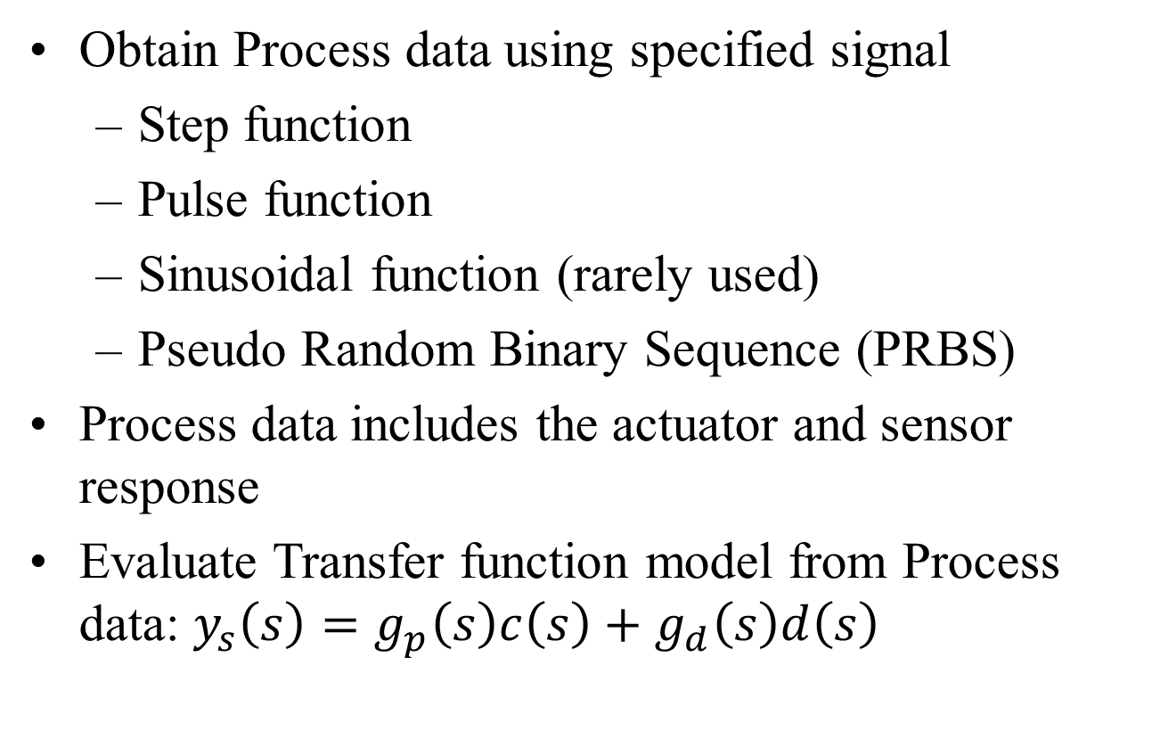
Transfer Function Model (Empirical)
Obtain Process data using specified signal
Step function
Pulse function
Sinusoidal function (rarely used)
Pseudo Random Binary Sequence (PRBS)
Process data includes the actuator and sensor response
Evaluate Transfer function model from Process data: $y_{s}\left(s\right)=g_{p}\left(s\right)c\left(s\right)+g_{d}\left(s\right)d\left(s\right)$

Slide 7
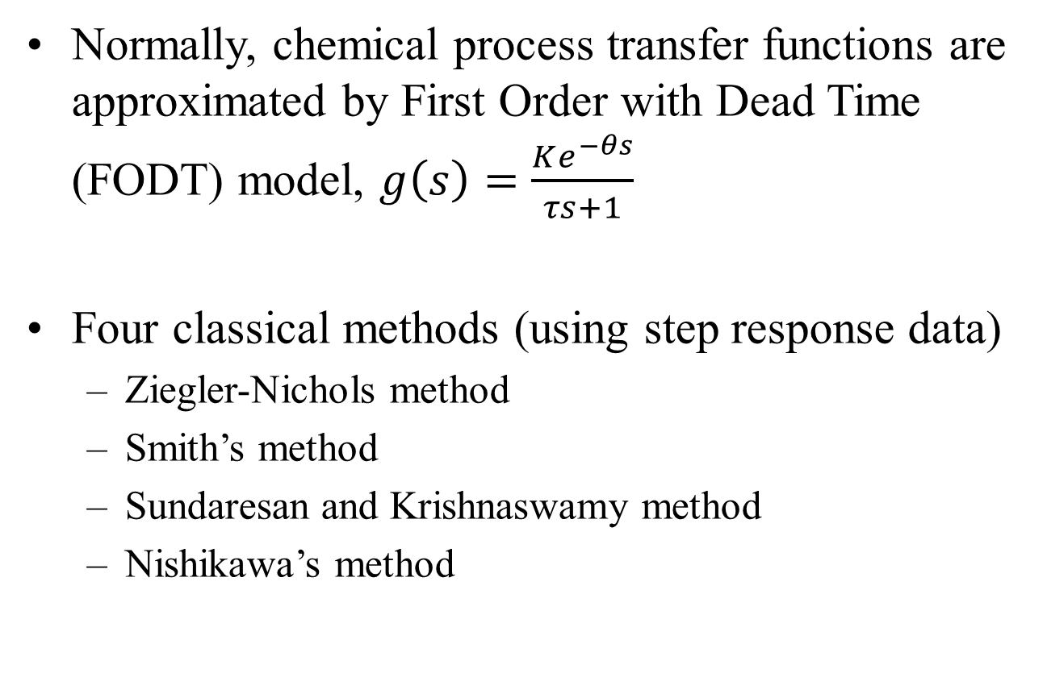
Transfer Function from Process Data
Normally, chemical process transfer functions are approximated by First Order with Dead Time (FODT) model, $g\left(s\right)=\frac{Ke^{−θs}}{τs+1}$
Four classical methods (using step response data)
Ziegler-Nichols method
Smith’s method
Sundaresan and Krishnaswamy method
Nishikawa’s method

Slide 8
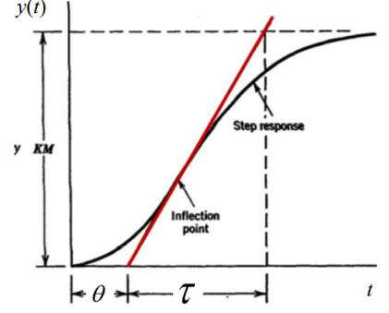
Transfer function from Process Data
Ziegler-Nichols method (1942) consists of applying a tangent line to the curve at an inflection point, to determine the system’s gain, time, and delay constants, as shown in Figure.
The inflection point is
defined where the curve
changes direction and the
derivative is equal to zero.
Drawback:
Difficult to find inflection
Point and to draw tangent.

Slide 9
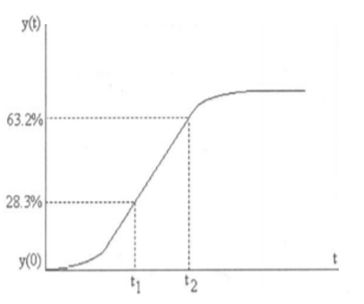
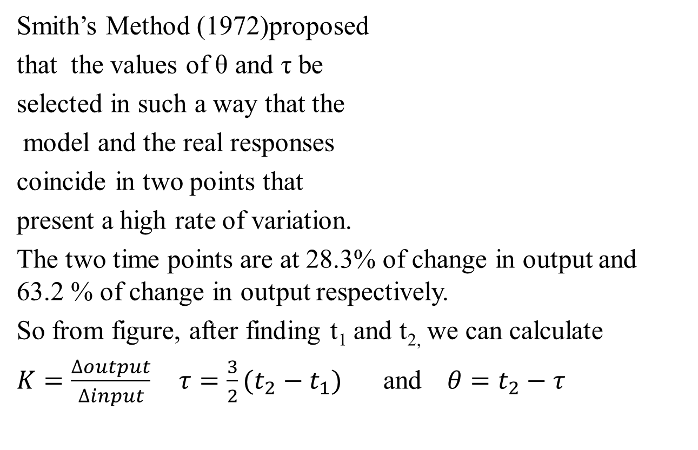
Transfer function from Process Data

Slide 10
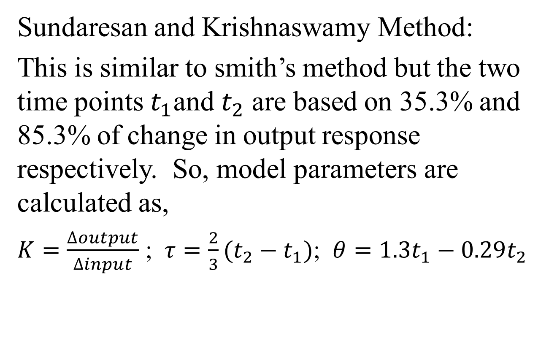
Transfer function from Process Data

Slide 11
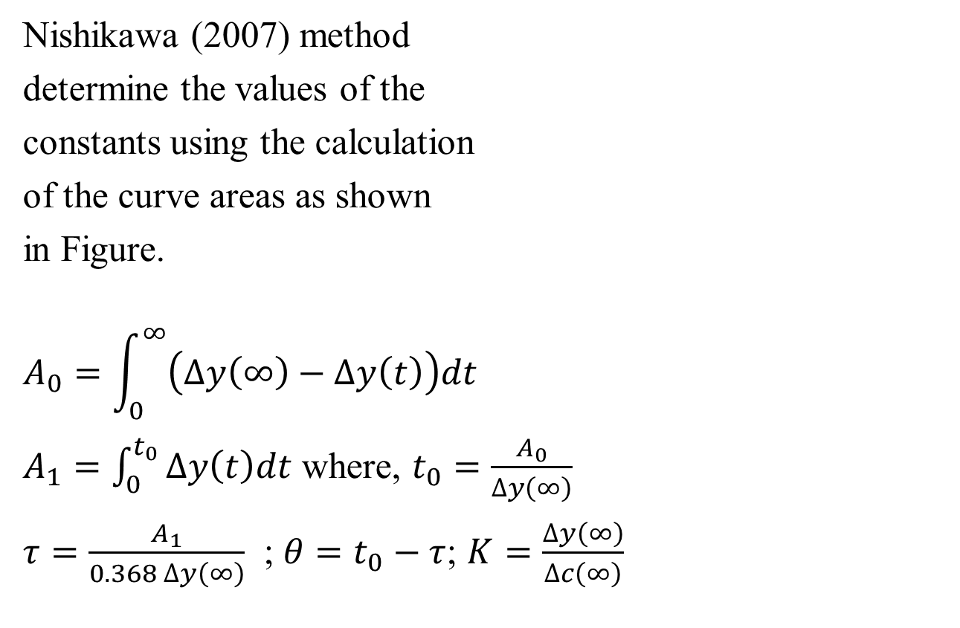
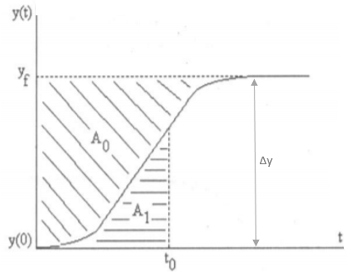
Transfer function from Process Data

Slide 12
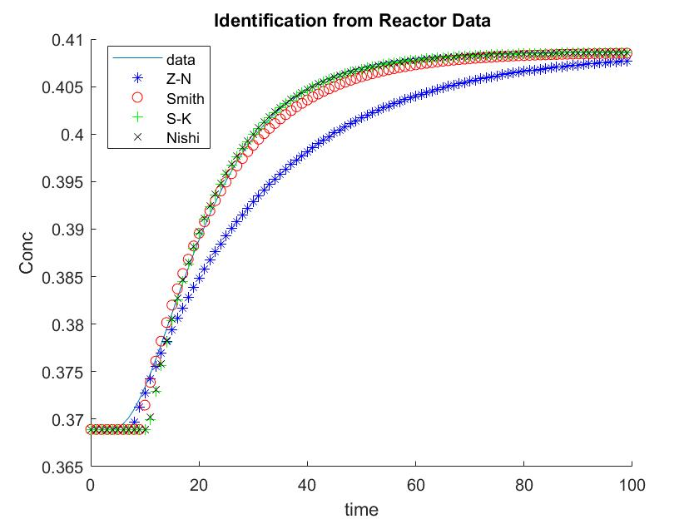
Method K Tau Theta Mape
Z-N 0.20 24.32 7.52 0.84
Smith 0.20 15.00 9.00 0.16
Sunder 0.20 12.73 10.65 0.11
Nishi 0.20 12.69 10.59 0.11

Slide 13
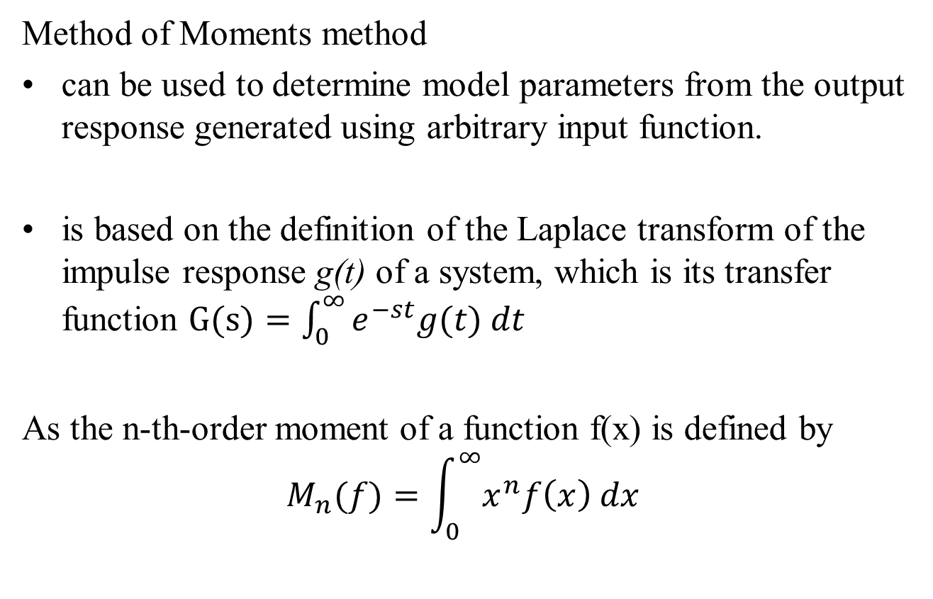
Transfer function from Process Data

Slide 14
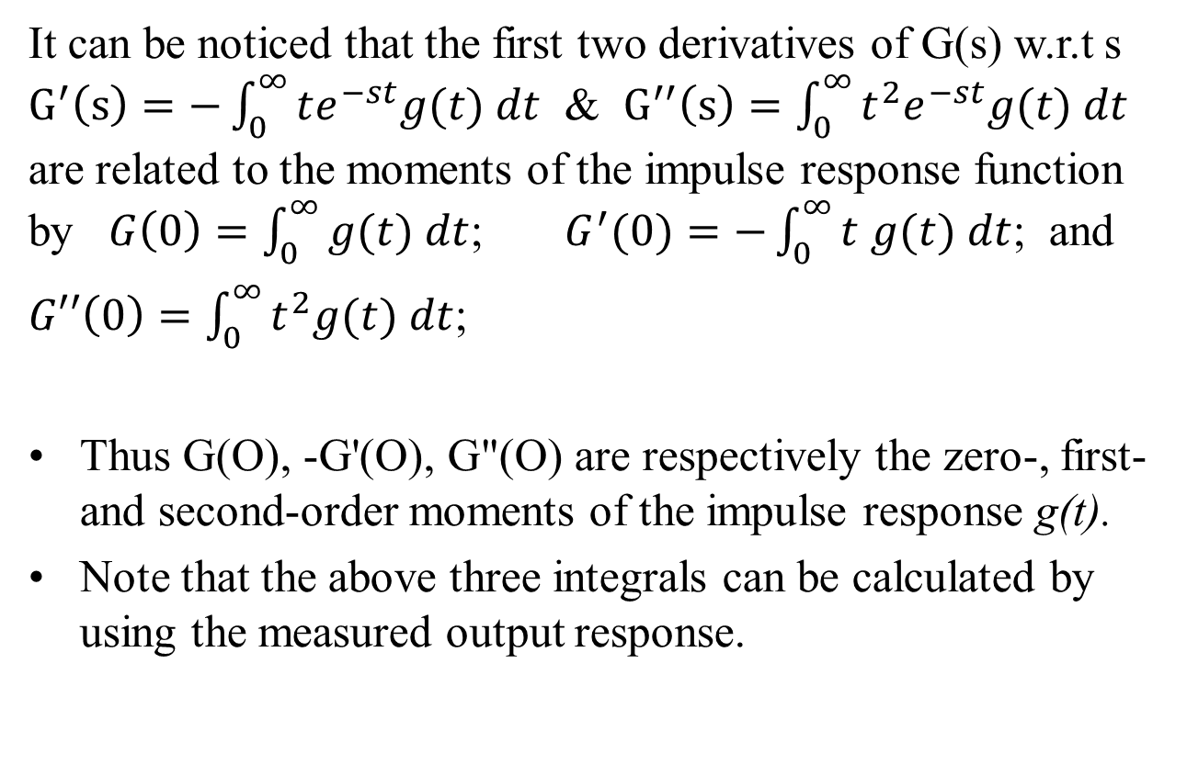
Transfer function from Process Data

Slide 15
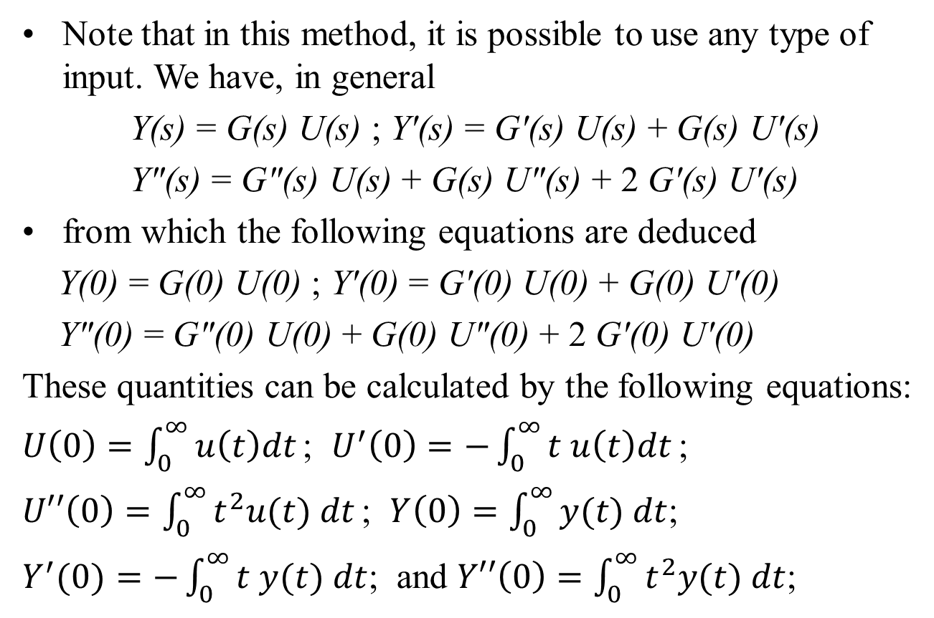
Transfer function from Process Data

Slide 16
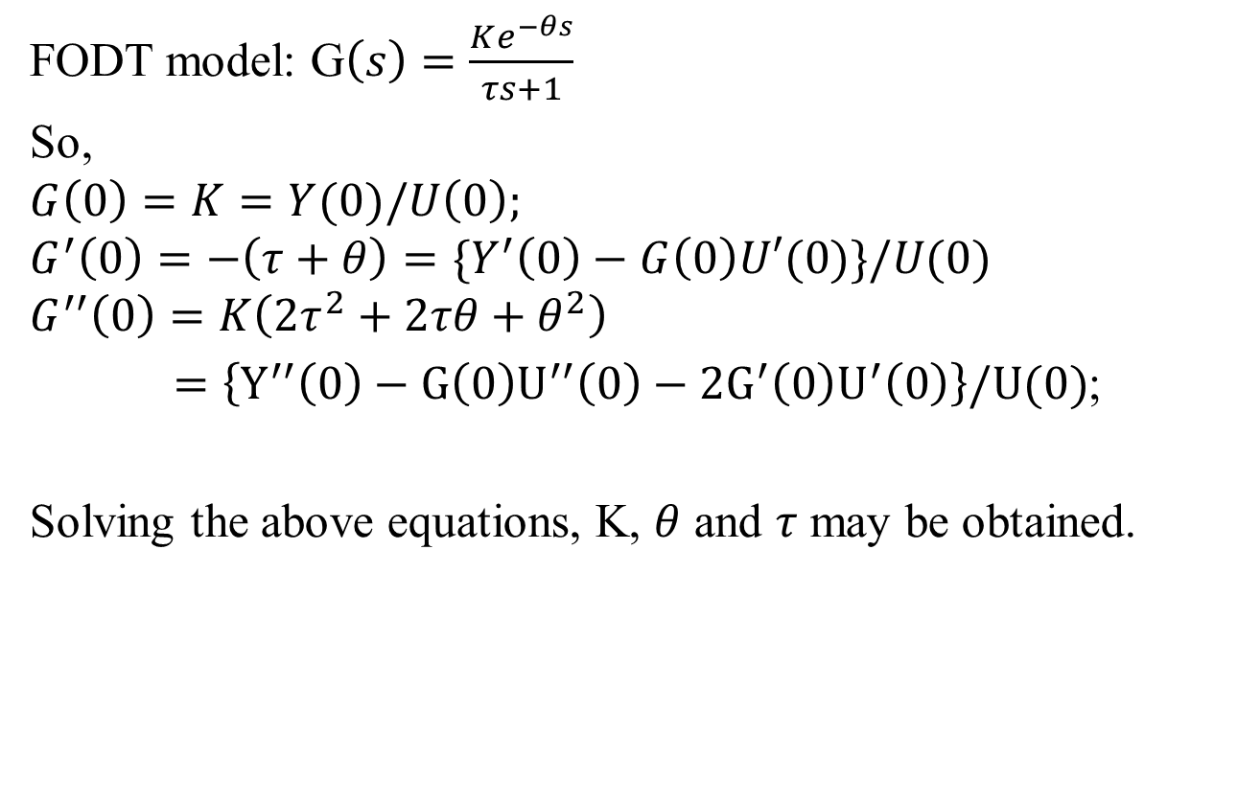
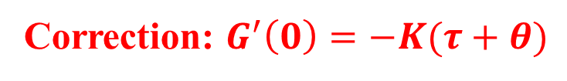
Transfer function from Process Data
Correction: $G^{′}\left(0\right)=−K(τ+θ)$

Slide 17
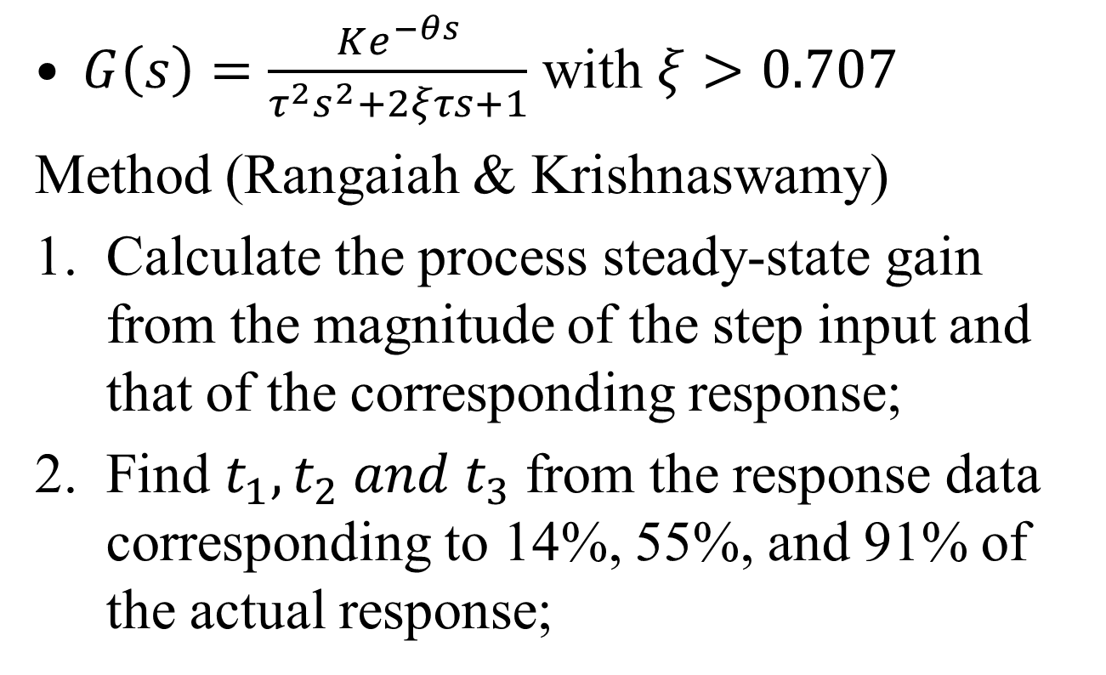
SODT model from step response
$G\left(s\right)=\frac{Ke^{−θs}}{τ^{2}s^{2}+2ξτs+1}$ with $ξ>0.707$
Method (Rangaiah & Krishnaswamy)
Calculate the process steady-state gain from the magnitude of the step input and that of the corresponding response;
Find $t_{1}, t_{2} and t_{3}$ from the response data corresponding to 14%, 55%, and 91% of the actual response;

Slide 18
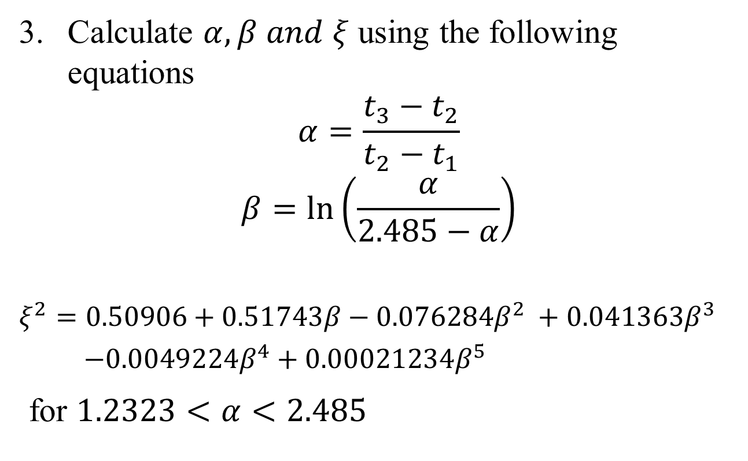
SODT model from step response
Calculate $α, β and ξ$ using the following equations
$$α=\frac{t_{3}−t_{2}}{t_{2}−t_{1}}$$
$$β=\ln\left(\frac{α}{2.485−α}\right)$$
$$ξ^{2}=0.50906+0.51743β−0.076284β^{2} +0.041363β^{3}$$
$−0.0049224β^{4}+0.00021234β^{5}$
for $1.2323<α<2.485$

Slide 19
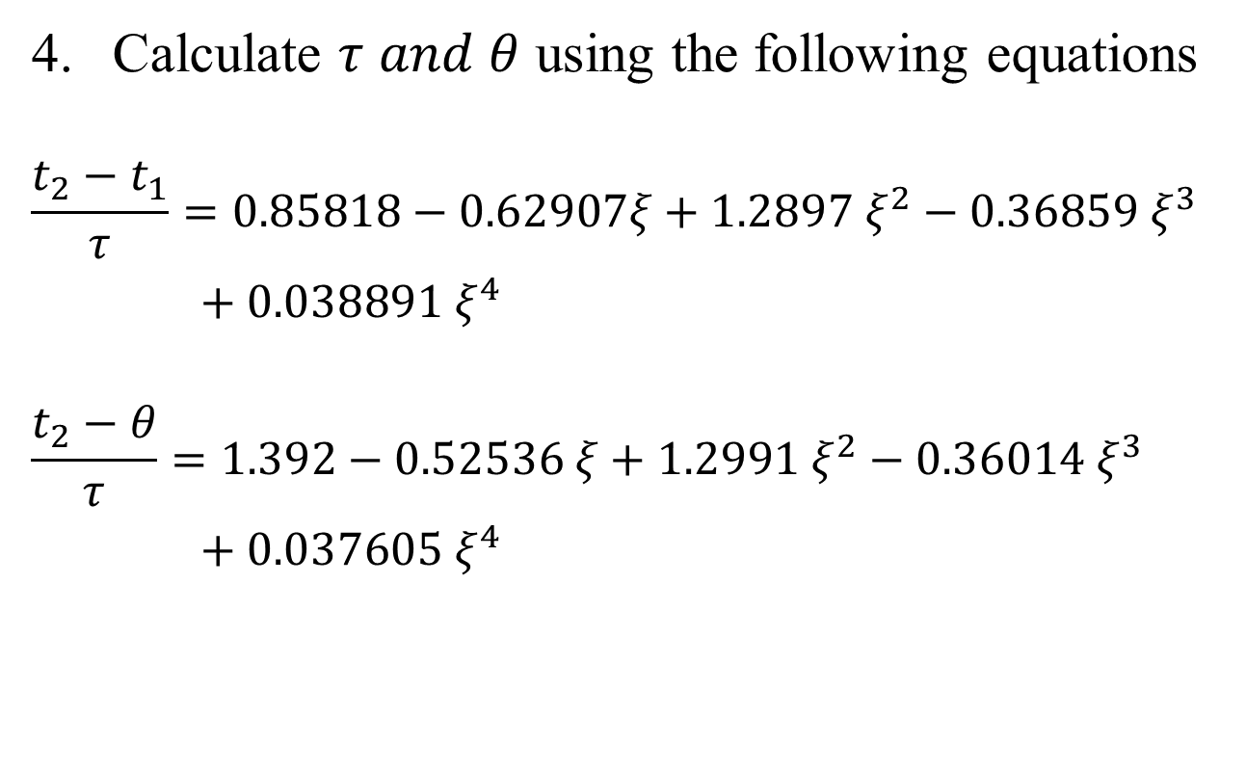
SODT model from step response
Calculate $τ and θ$ using the following equations
$$\frac{t_{2}−t_{1}}{τ}=0.85818−0.62907ξ+1.2897{ ξ}^{2}−0.36859{ ξ}^{3}$$
$+ 0.038891 ξ^{4}$
$$\frac{t_{2}−θ}{τ}=1.392−0.52536 ξ+1.2991 ξ^{2}−0.36014 ξ^{3}$$
$+ 0.037605 ξ^{4}$

Slide 20
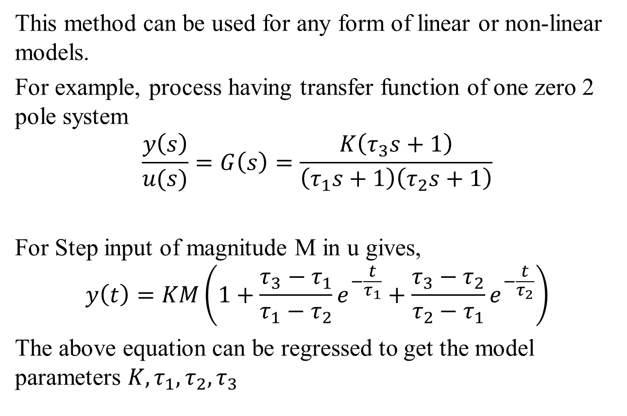
Non-linear Regression
This method can be used for any form of linear or non-linear models.
For example, process having transfer function of one zero 2 pole system
$$\frac{y\left(s\right)}{u(s)}=G\left(s\right)=\frac{K\left(τ_{3}s+1\right)}{\left(τ_{1}s+1\right)\left(τ_{2}s+1\right)}$$
For Step input of magnitude M in u gives,
$$y\left(t\right)=KM\left(1+\frac{τ_{3}−τ_{1}}{τ_{1}−τ_{2}}e^{−\frac{t}{τ_{1}}}+\frac{τ_{3}−τ_{2}}{τ_{2}−τ_{1}}e^{−\frac{t}{τ_{2}}}\right)$$
The above equation can be regressed to get the model parameters $K, τ_{1}, τ_{2}, τ_{3}$

Slide 21
Matlab Implementation
Step response data:
t | 0 | 1 | 2 | 3 | 4 | 5 | 6 | 7 | 8 | 9 | 10
u | 1 | 1 | 1 | 1 | 1 | 1 | 1 | 1 | 1 | 1 | 1
y | 0 | 0.058 | 0.217 | 0.36 | 0.488 | 0.6 | 0.692 | 0.772 | 0.833 | 0.888 | 0.925
Use command
mdl = procest(data, Type)
Where, data should stored in iddata format.
Type =‘P2DUZ’ [ 2 poles, delay, U underdamped, Z zero]
>> u=[0;0;0;u]; y=[0;0;0;y]; % for step changes
>> z = iddata(y, u, 1); % y and u should be column vectors
>> mdl= procest(z,’P2DUZ’);
‘procest’ can work for step as well as arbitrary input changes.

Slide 22
PID Controller
The acronym PID stands for:
P - Proportional
I - Integral
D - Derivative
PID Controllers:
greater than 90% of all control implementations
dates back to the 1930s
very well studied and understood
optimal structure for first and second order processes (given some assumptions)
always first choice when designing a control system

Slide 23
PID Control Algorithm
e(t)- the error from setpoint [e(t) = y_{sp} - y_{s}].
K_{c}- the controller gain is a tuning parameter and largely determines the controller aggressiveness.
τ_{I}- the reset time is a tuning parameter and determines the amount of integral action.
τ_{D}- the derivative time is a tuning parameter and determines the amount of derivative action.

Slide 24
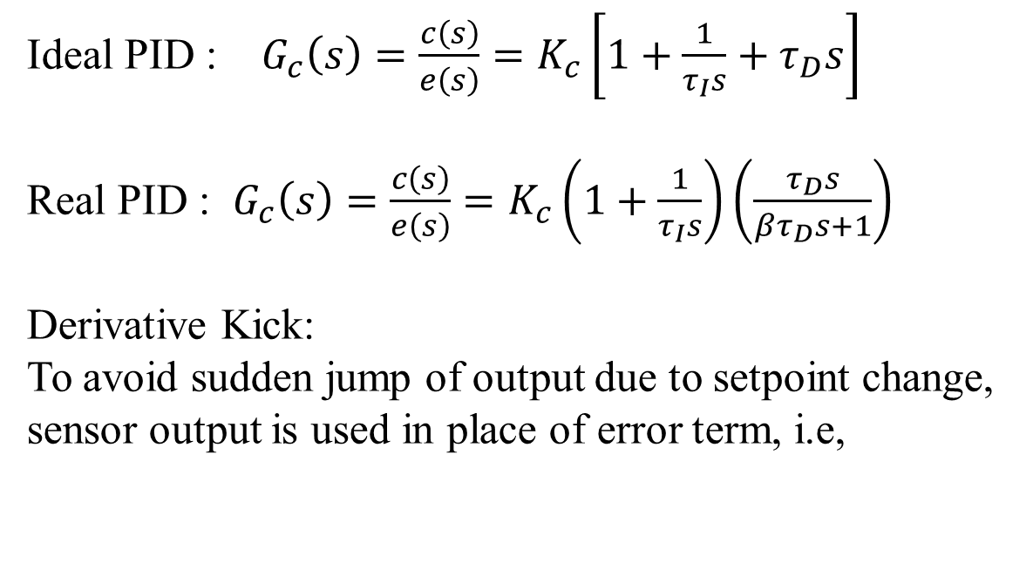
Transfer Function for a PID Controller
Ideal PID : $G_{c}\left(s\right)=\frac{c\left(s\right)}{e\left(s\right)}=K_{c}\left[1+\frac{1}{τ_{I}s}+τ_{D}s\right]$
Real PID : $G_{c}\left(s\right)=\frac{c\left(s\right)}{e\left(s\right)}=K_{c}\left(1+\frac{1}{τ_{I}s}\right)\left(\frac{τ_{D}s}{βτ_{D}s+1}\right)$
Derivative Kick:
To avoid sudden jump of output due to setpoint change, sensor output is used in place of error term, i.e,

Slide 25
Digital Equivalent of PID Controller
The trapezoidal approximation of the integral.
Backward difference approximation of the first derivative

Slide 26
Digital Version of PID Control Algorithm

Slide 27
Derivation of the Velocity Form of the PID Control Algorithm

Slide 28
Velocity Form of PID Controller
Note the difference in proportional, integral, and derivative terms from the position form.
Velocity form is the form implemented on DCSs.

Slide 29
Correction for Derivative Kick
Derivative kick occurs when a setpoint change is applied that causes a spike in the derivative of the error from setpoint.
Derivative kick can be eliminated by replacing the approximation of the derivative based on the error from setpoint with the negative of the approximation of the derivative based on the measured value of the controlled variable, i.e.,

Slide 30
Correction for Aggressive Setpoint Tracking
For certain process, tuning the controller for good disturbance rejection performance results in excessively aggressive action for setpoint changes.
This problem can be corrected by removing the setpoint from the proportional term. Then setpoint tracking is accomplished by integral action only.

Slide 31
The Three Versions of the PID Algorithm Offered on DCS’s
(1) The original form in which the proportional, integral, and derivative terms are based on the error from setpoint

Slide 32
The Three Versions of the PID Algorithm Offered on DCSs
(2) The form in which the proportional and integral terms are based on the error from setpoint while the derivative-on-measurement is used for the derivative term.

Slide 33
The Three Versions of the PID Algorithm Offered on DCS’s
(3) The form in which the proportional and derivative terms are based on the process measurement and the integral is based on the error from setpoint.

Slide 34
Guidelines for Selecting Direct and Reverse Acting PID’s
Consider a direct acting final control element to be positive and reverse to be negative.
If the sign of the product of the final control element and the process gain is positive, use the reverse acting PID algorithm.
If the sign of the product is negative, use the direct acting PID algorithm
If control signal goes to a control valve with a valve positioner, the actuator is considered direct acting.

Slide 35
Level Control Example
Process gain is positive because when flow in is increased, the level increases.
If the final control element is direct acting, use reverse acting PID.
For reverse acting final control element, use direct acting PID.

Slide 36
Level Control Example
Process gain is negative because when flow out is increased, the level decreases.
If the final control element is direct acting, use direct acting PID.
For reverse acting final control element, use reverse acting PID.

Slide 37
General Feedback Control Loop
d(s)
G_{d}(s)
y_{sp}(s)
e(s)
c(s)
u(s)
G_{P}(s)
+
y(s)
K_{S}
-
G_{C}(s)
G_{a}(s)
+
+
y_{S}(s)
G_{S}(s)

Slide 38
Closed Loop Transfer Functions
From the general feedback control loop and using the properties of transfer functions, the following expressions can be derived:

Slide 39
Characteristic Equation
Since setpoint tracking and disturbance rejection have the same denominator for their closed loop transfer functions, this indicates that both setpoint tracking and disturbance rejection have the same general dynamic behavior.
The roots of the denominator determine the dynamic characteristics of the closed loop process.
The characteristic equation is given by:

Slide 40
Feedback Control Analysis
The loop gain (K_{c}K_{a}K_{p}K_{s}) should be positive for stable feedback control.
An open-loop unstable process can be made stable by applying the proper level of feedback control.

Slide 41
Thank You

Slide 43
Typical Globe Control Valve

Slide 44
Cross-section of a Globe Valve

Slide 45
Types of Globe Valves
Quick Opening- used for safety by-pass applications where quick opening is desired
Equal Percentage- used for about 90% of control valve applications since it results in the most linear installed characteristics
Linear- used when a relatively constant pressure drop is maintained across the valve

Slide 46
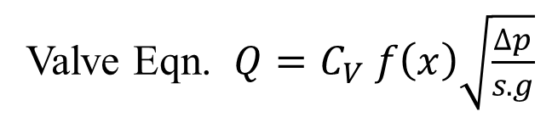

Inherent Valve Characteristics
Valve Eqn. $Q=C_{V} f\left(x\right)\sqrt{\frac{∆p}{s.g}}$
Linear:
$$f\left(x\right)=x$$
Quick opening
$$f\left(x\right)=\sqrt{x}$$
Equal %
$$f\left(x\right)=R^{x−1}$$
R varies 20 to 50

Slide 47
Pressure Drop vs. Flow Rate

Slide 48
Installed Flow Characteristic

Slide 49
Control Valve Design Procedure
Evaluate C_{v} at the maximum and minimum flow rate using the flow equation for a valve.
Determine which valves can effectively provide the max and min flow rate remembering that, in general, the valve position should be greater than about 15% open for the minimum flow rate and less than 85% open for the maximum flow rate.
Choose the smallest valve that meets the above criterion for the minimum capital investment or choose the largest valve to allow for future throughput expansion.

Slide 50
Additional Information Required to Size a Control Valve
C_{V} versus % open for different valve sizes.
Available pressure drop across the valve versus flow rate for each valve. Note that the effect of flow on the upstream and downstream pressure must be known.

Slide 51
Valve Deadband
It is the maximum change in instrument air pressure to a valve that does not cause a change in the flow rate through the valve.
Deadband determines the degree of precision that a control valve or flow controller can provide.
Deadband is primarily affected by the friction between the valve stem and the packing.

Slide 52
Valve Actuator Selection
Choose an air-to-open for applications for which it is desired to have the valve fail closed.
Choose an air-to-close for applications for which it is desired to have the valve fail open.
Back

